Slide 1
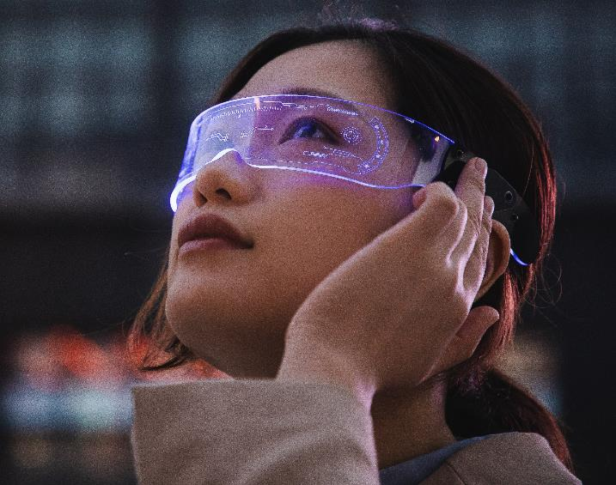
Augmented Reality

Slide 2
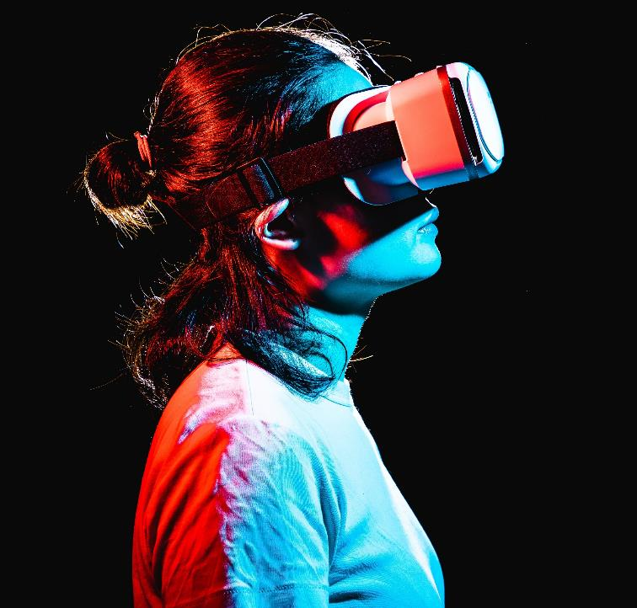
Present by:
Mr. Barthasarathy.T
Mr.Abinath.T
Mr.Aswin Kumar.E
Mr.Abinesh Karthick.K

Slide 3
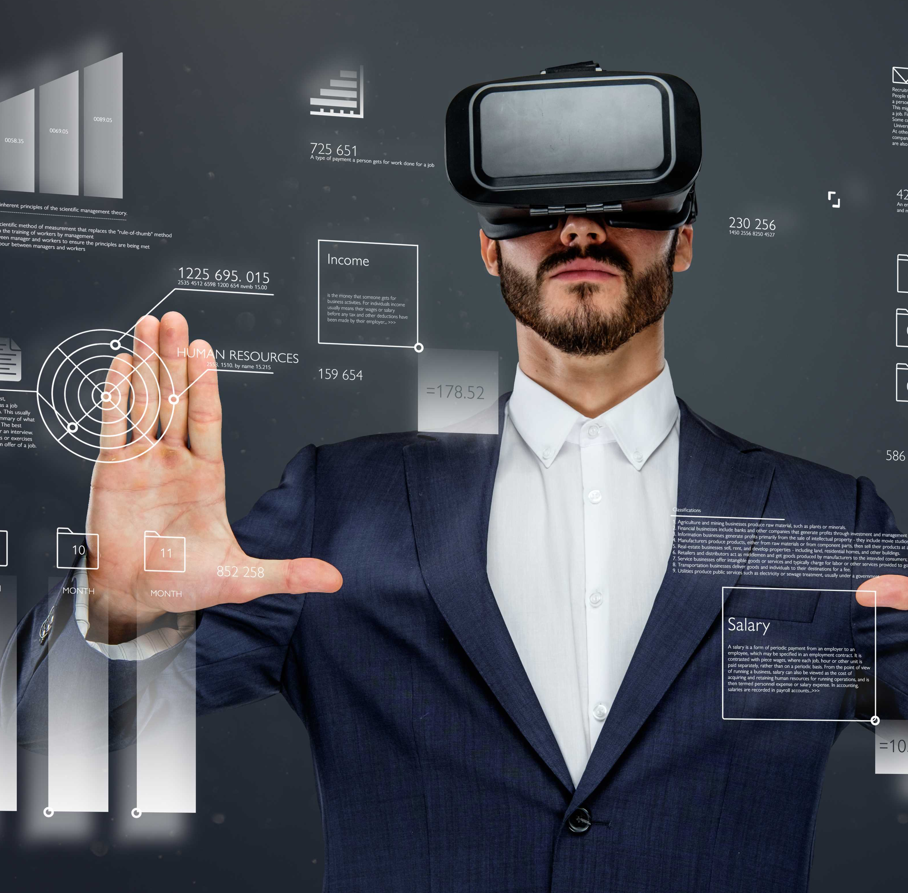
Application of Augmented Reality
Improved learning
Enhanced user experience
Increased efficiency
Cost savings
Improved customer engagement
Enhanced safety and security

Slide 4
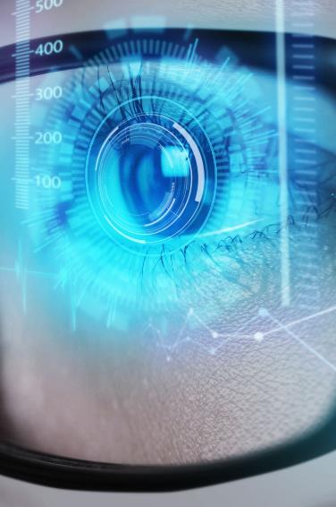
FIELD OF VIEW (FoV) in vr
The FoV in VR headsets mimics the natural human field of view typically, around 100-110 degrees or more to cover most of what our eyes can see
This immersion makes to feel like digital environment surrounds you

Slide 5

The Advantages of AR in Education
AR has enormous potential in education, as it can enhance traditional teaching methods by providing interactive and engaging experiences for students. For example, AR can be used to create digital models of complex concepts, such as the human body or the solar system, allowing students to explore and interact with them in a way that was not possible before.

Slide 6

MOTION TRAKING SYSTEM
Head Traking
Sensors in VR headsets track head position and orientation when you turn your head the virtual world moves accordingly
Full Body tracking
The sensors are attached fully in room so it enables to walk run jump in VR
Hand and Contoller tracking
Hand held controllers allow the person to manipulate the virtual object directly

Slide 7

AR in Entertainment : A New Era of Immersive Experiences
AR has already started to transform the entertainment industry, as it allows users to experience digital content in a more immersive and interactive way. AR games, for example, can overlay digital characters and objects onto the real world, creating a new kind of gameplay that blends virtual and physical elements.

Slide 8
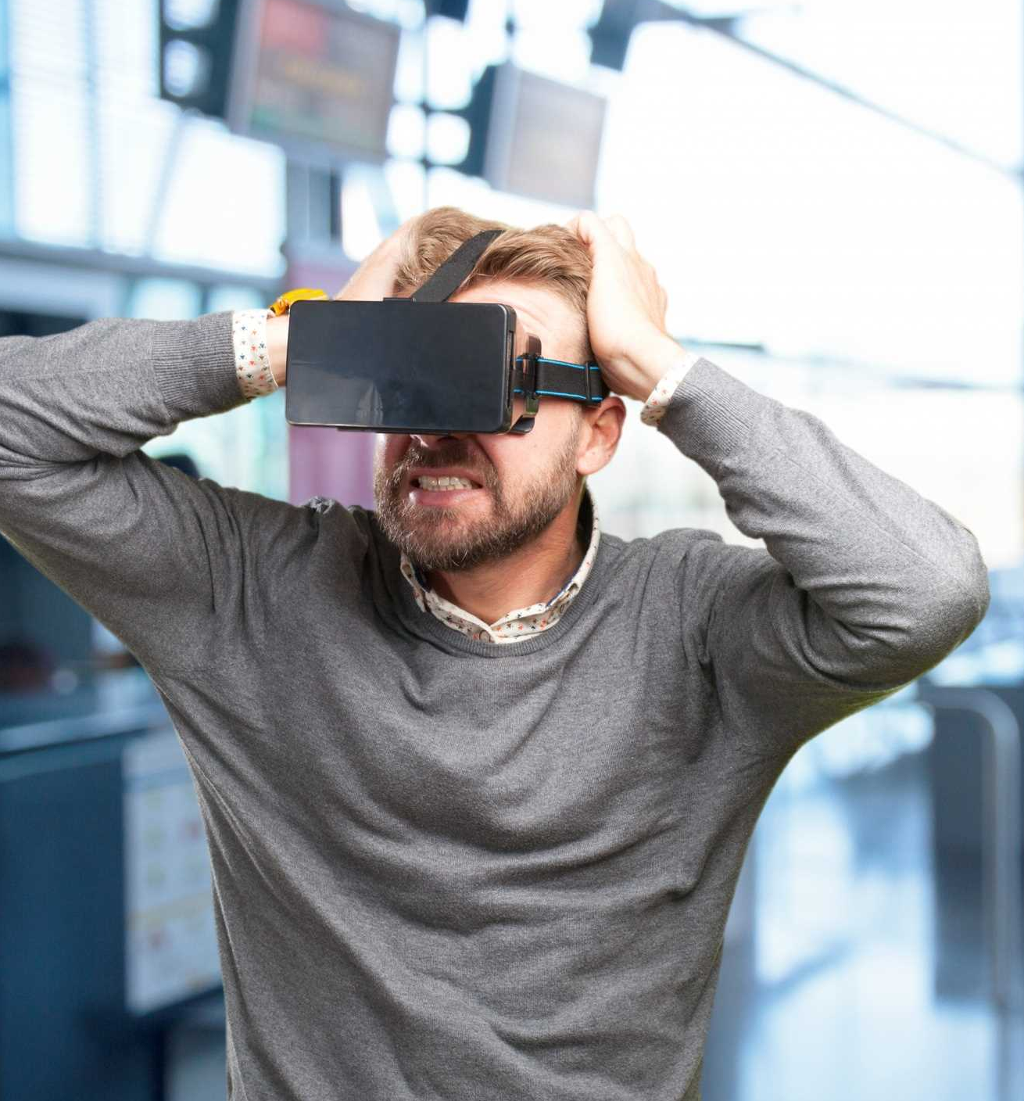
L
Disadvantaged AR
The disadvantages of Augmented Reality include privacy and ethical concerns, high development costs, technical limitations, and potential negative impact on social interactions and physical activity.

Slide 9

TECHNOLOGY LIKE AUGMENTed REALITY
Mixed Reality (MR):
Combines element of both Vrand AR allowing real and virtual environment to interact in real time
Brain Computer Interaction:
Though in its early stages BCI allows direct communication between the brain and the computer
Smart Glasses
It allows to make viedo call,watch moviesand gaming in daily day life

Slide 10
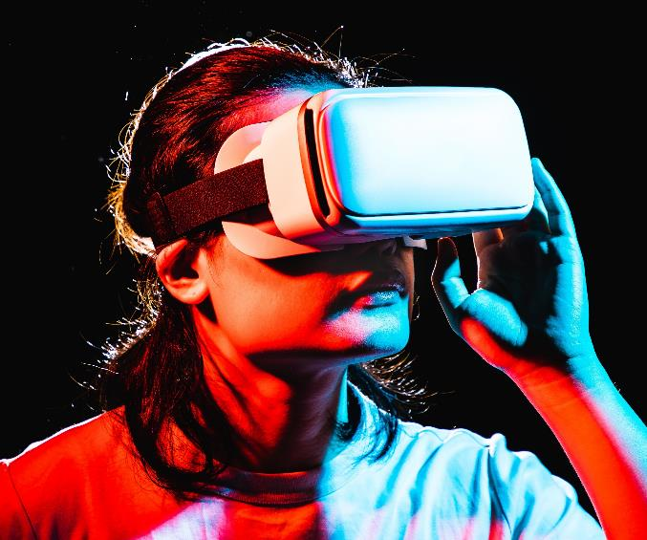
"Augmented reality is the future, and it's going to be here sooner than we think."

Slide 11
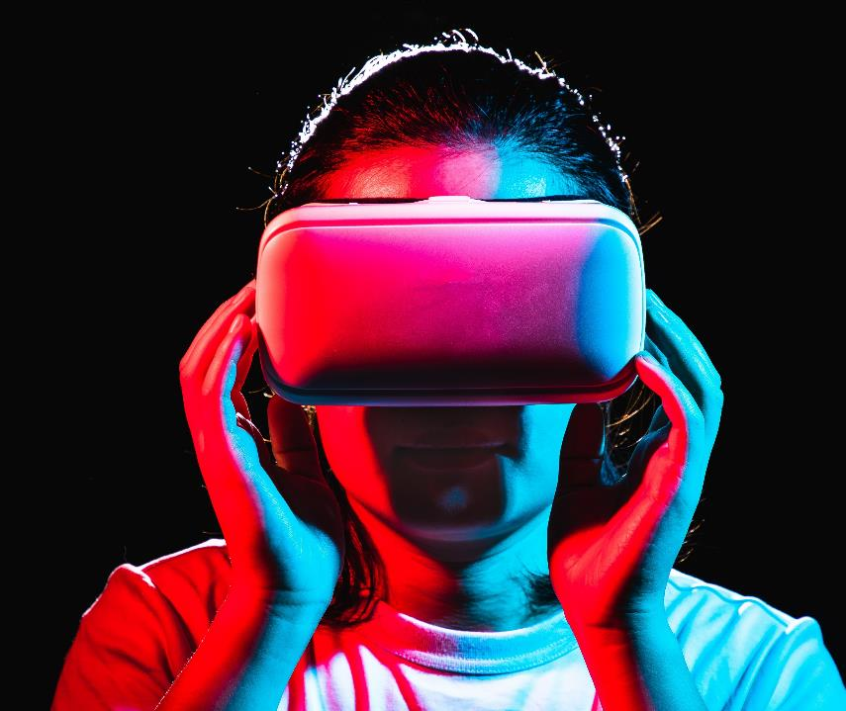
Thank you

